Slide 1
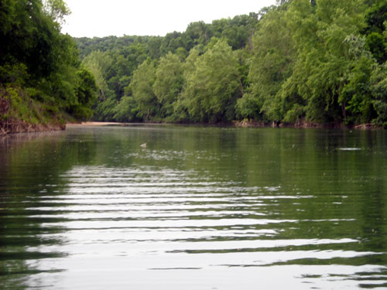
Water Quality Monitoring and Constituent Load Estimation in the Kings River near Berryville, Arkansas 2009
Brian E. Haggard
Arkansas Water Resources Center
UA Division of Agriculture
Funded by ANRC through Kings River Watershed Partnership

Slide 2
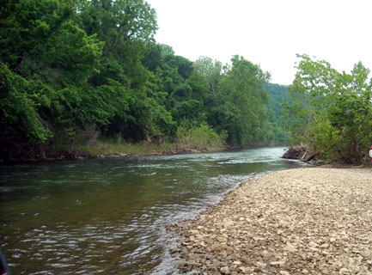
2009 Summary:
Loads and Flow-Weighted Concentrations
 | Cl | SO₄ | NH₃-N | NO₃-N | SRP | TN | TP | TSS
Loads | 2,156,000 | 4,170,000 | 47,000 | 663,000 | 51,000 | 920,000 | 250,000 | 169,710,000
FWC | 3.05 | 5.05 | 0.06 | 0.80 | 0.06 | 1.11 | 0.30 | 206

Slide 3
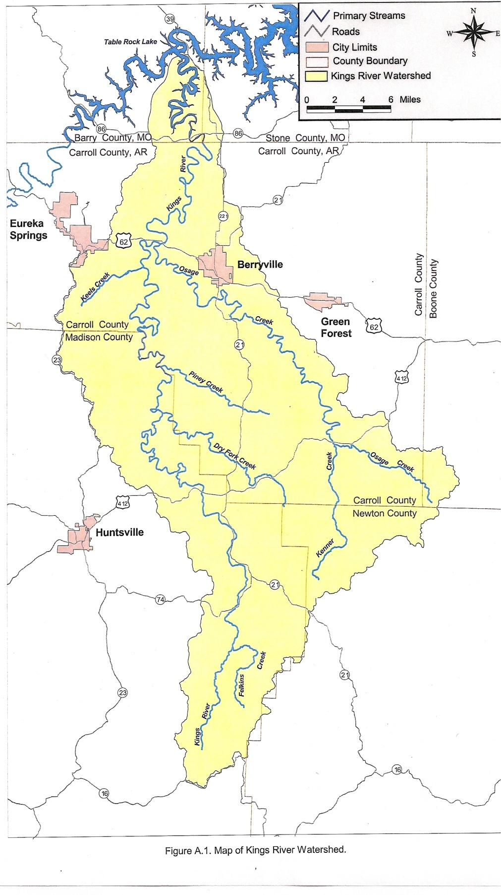
Water samples were collected at the Kings River near Berryville, Arkansas
Sampling Location
Stage was recorded in 30 min intervals by the USGS to estimate discharge
Water samples were collected once a week and targeted storm events
Water samples were analyzed for nitrate-N, ammonia-N, total N, total P, soluble reactive P, total suspended solids, sulfate and chloride

Slide 4
Load Determination & Mean Concentration
Linear regression was used to determine the relationship between daily load, flow and seasonal factors:
  ln(L_{d}) = β_{o} + β₁ln(Q_{d})
  —or—
  ln(L_{d}) = β_{o} + β₁ln(Q_{d}) + β₂sin(2πT) + β₃cos(2πT)
BCF was used to remove bias from log transformations:
BCF= | ∑e^{R}
 | n

Slide 5
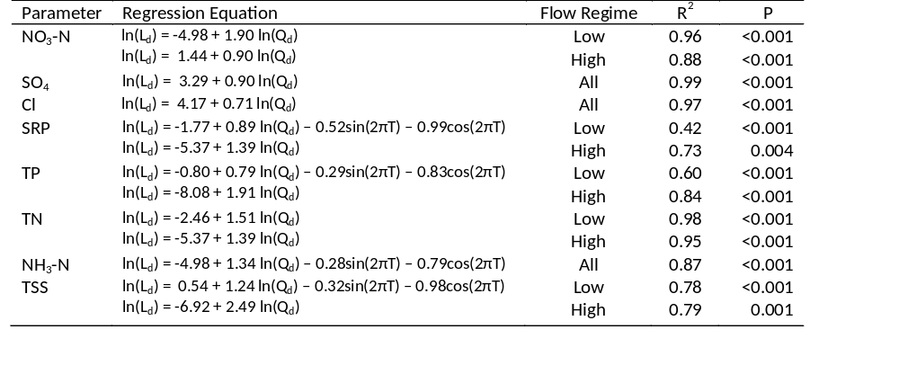
Some constituents exhibited seasonal effects…

Slide 6
And, some constituents required hydrograph separation…

Slide 7
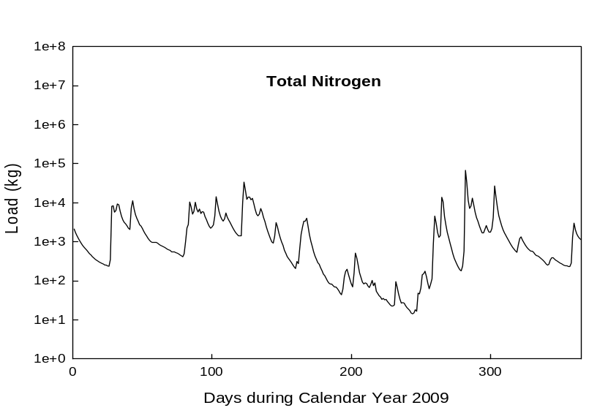
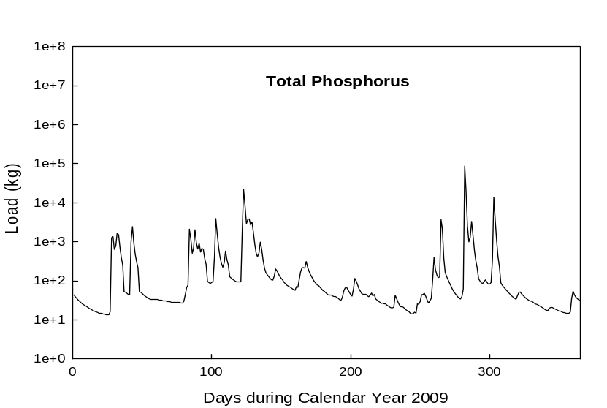
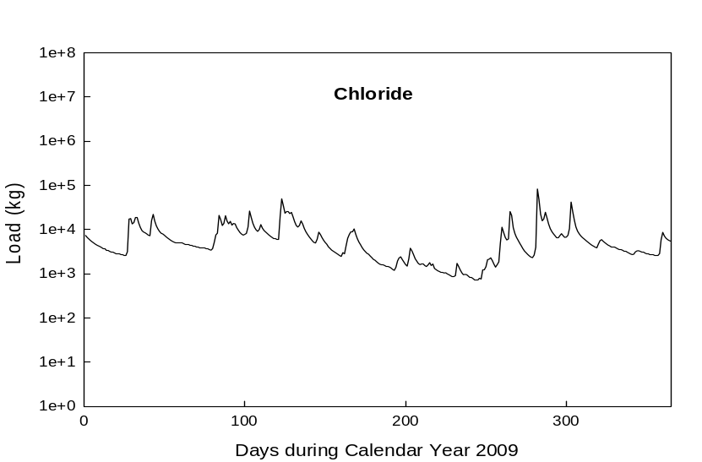
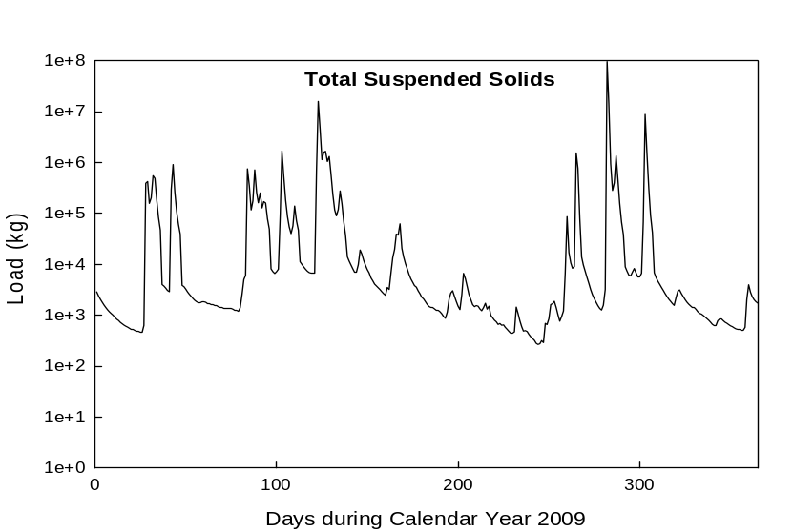
Daily Loads were variable…

Slide 8
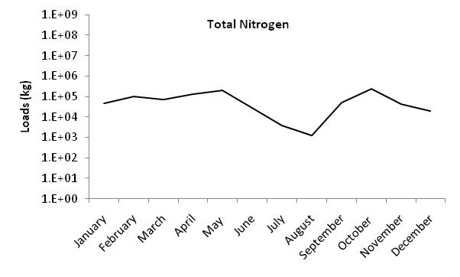
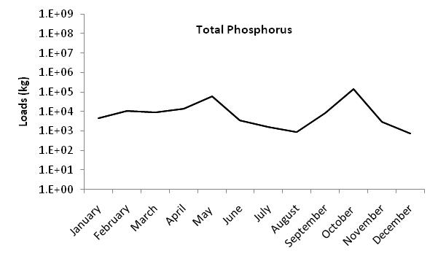
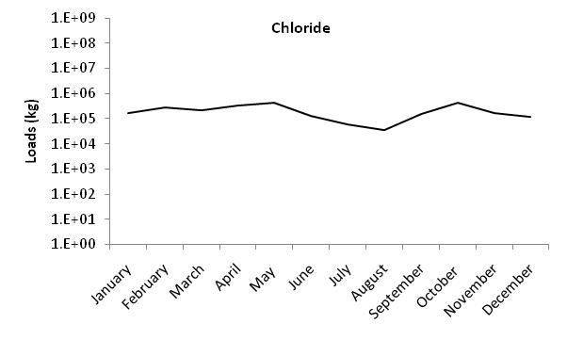
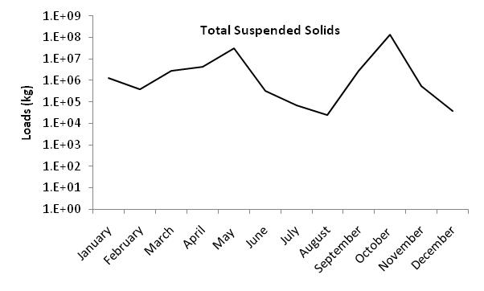
Monthly Loads were least during late summer…

Slide 9
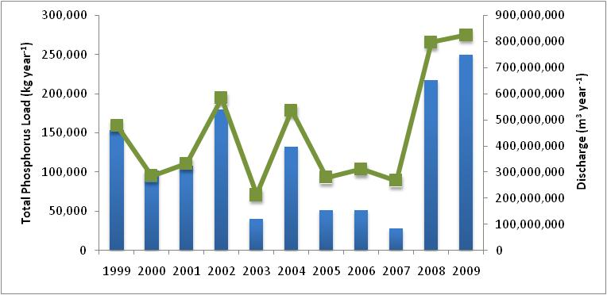
Phosphorus loads have been variable following the general trend in annual discharge.

Slide 10
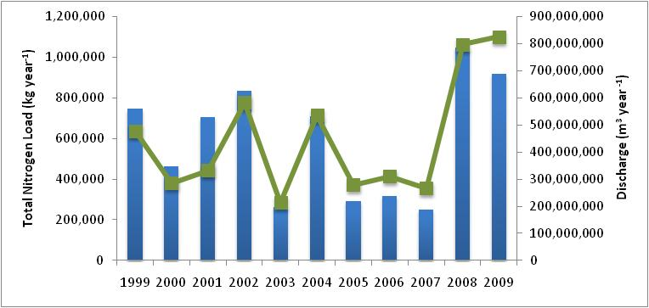
Nitrogen loads in 2009 were less than that observed in 2008, even though discharge increased.

Slide 11
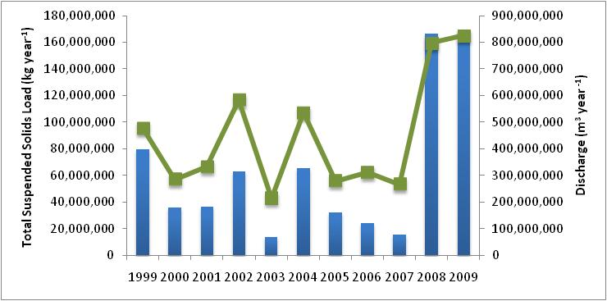
Total suspended solids loads in 2009 were similar to that observed in 2008.

Slide 12
The new monitoring program was successful at estimating loads at the Kings River.
The regressions used to estimate loads considered seasonal effects, where appropriate
And, this site also showed different relations between concentration and discharge at low and high flow

